Slide 1
Face Mask Detection Computer Vision Project
By:
Anuram Anil B200713CS
Aswin Sreekumar B200737CS
Rithika Kathirvel B200055CS

Slide 2
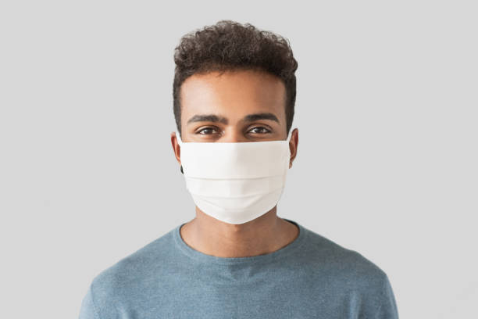
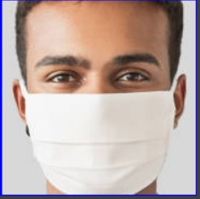
Face detection - using haar model
It’s a model available in OpenCV library.
Pretrained on a large dataset.
Detect human faces in images.
Using this model we ensure that only a single face is present.
The model also defines a solid boundary around the detected face.

Slide 3
Setting Up Data and Model
Data Loading:
Dataset consists of around 2000 images each in both masked and unmasked faces
Labels are one-hot encoded.
Data Split:
The dataset is split into training and testing sets (80% training, 20% testing).
Data Augmentation:
Data augmentation is applied to the training set.
Augmentation includes rotation, zoom, shifts, shear, and horizontal flip.

Slide 4
Model Architecture
Base Model: MobileNetV2
Pre-trained MobileNetV2 is used as the base model.
It provides efficiency even in resource-constrained scenarios
Custom Head Model:
Average pooling layer is added to the base model output.
Flatten layer transforms the output into a vector.
One dense layer is added, with ReLU activation and dropout.
Final dense layer with softmax activation for binary classification.

Slide 5
Model Training and Optimization
Freezing Base Model:
All layers in the base model are frozen (not trainable).
Optimizer:
Adam optimizer with a learning rate schedule.
Model Compilation:
Binary cross-entropy loss for binary classification.
Model Training:
Model is trained using the augmented training data.
Validation data is used to monitor model performance.
Result :
Gives an accuracy of 97.76% on test data

Slide 6
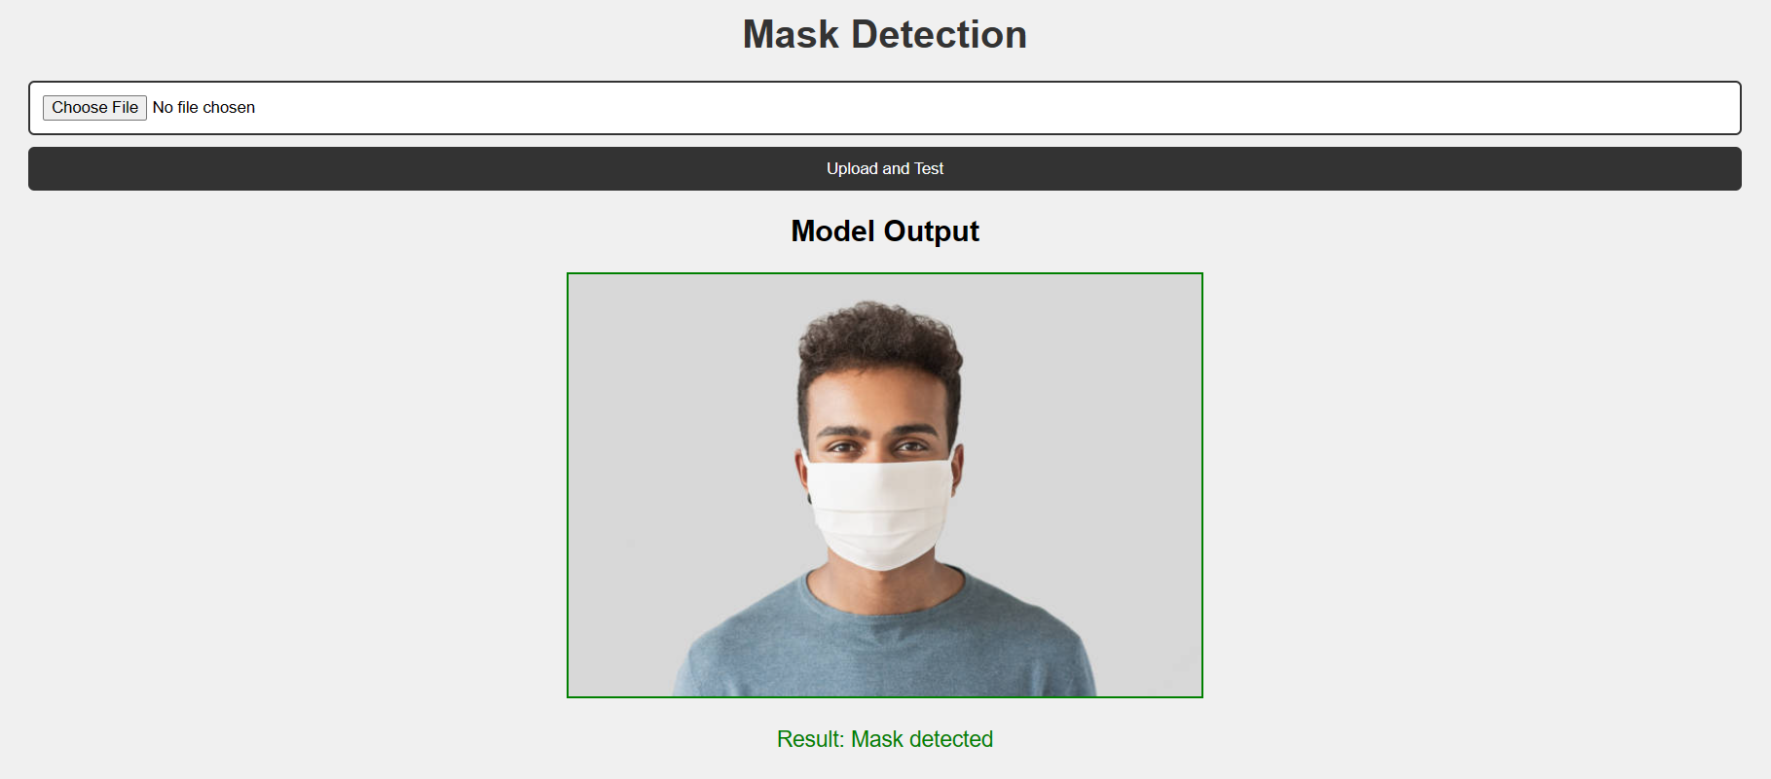
Image Assessment workflow
Users upload images through the UI
In the backend the image is first sent to the haar face detection model
From there the cropped face image is sent to the mask detection model
The image is classified by this model and the result is displayed to the user.

Slide 7
Thank you

